Slide 1

WELCOME
Intelligent Course Scheduler

Slide 2
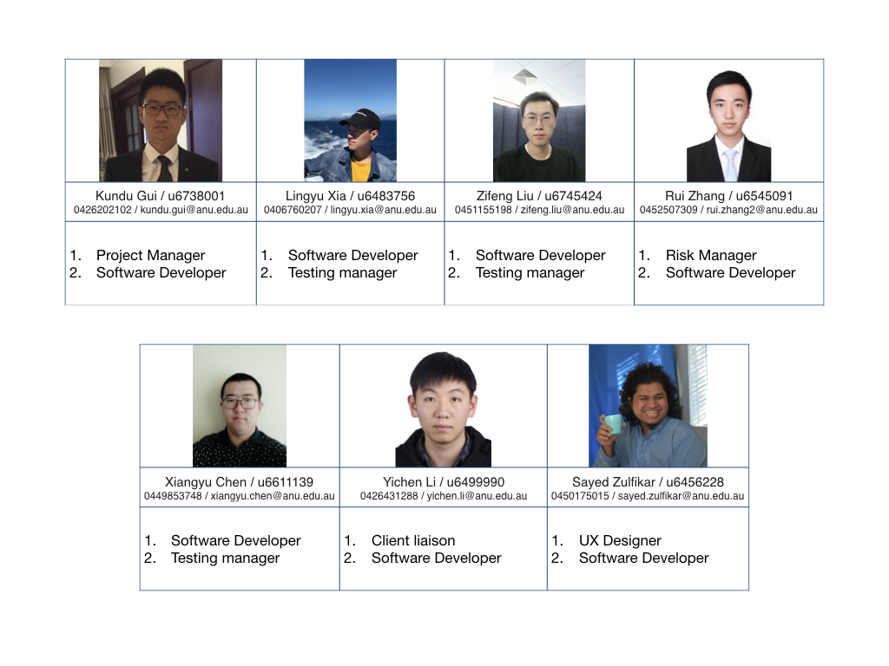
Team Members We are a newly formed project team
Intelligent Course Scheduler

Slide 3
Project Introduction
Intelligent Course Scheduler
This project will upgrade the former intelligent Course Scheduler project in many fields including improving Graphical User Interface (GUI), offering access control for ANU staff and former bugs fixing.
The Intelligent Course Scheduler, currently known as ANU ICS, offers interactive degree planning and personalised course discovery to make picking courses simple and enjoyable for students.
It uses machine learning to recommend courses to students, and provides university administrators with a structured data model of the entire system of courses, majors, and degree requirements.

Slide 4

Main Stakeholders
Intelligent Course Scheduler
Our Key Stakeholders and their Expectations:

Slide 5
Milestones (five main work objectives) 1. Graphical User Interface 2. CRUD 3. Access control 4. Copy and paste functions 5. Bug fixing
Intelligent Course Scheduler
1 | The graphical user interface is a form of user interface. Good GUI can bring a better user experience. Our job is to improve the existing user interface and add some features.
2 | Create, read, update, and delete (CRUD) are the four basic functions for this website. The website will read the data from the database and provide the information the user needs. These functions are the basis of access control system.
3 | Access control allow ANU staffs to login into the website and change course information. Website administrators can also modify the database by using this system.
4 | Copy and paste functions are advanced functions for the website. Students can copy existing timetable from other students or template. These function can help students complete their study plan faster.
5 | There are some bugs in the website. For example, in some situations, the website will generate incomplete timetable. Our job is to fix these bugs.

Slide 6
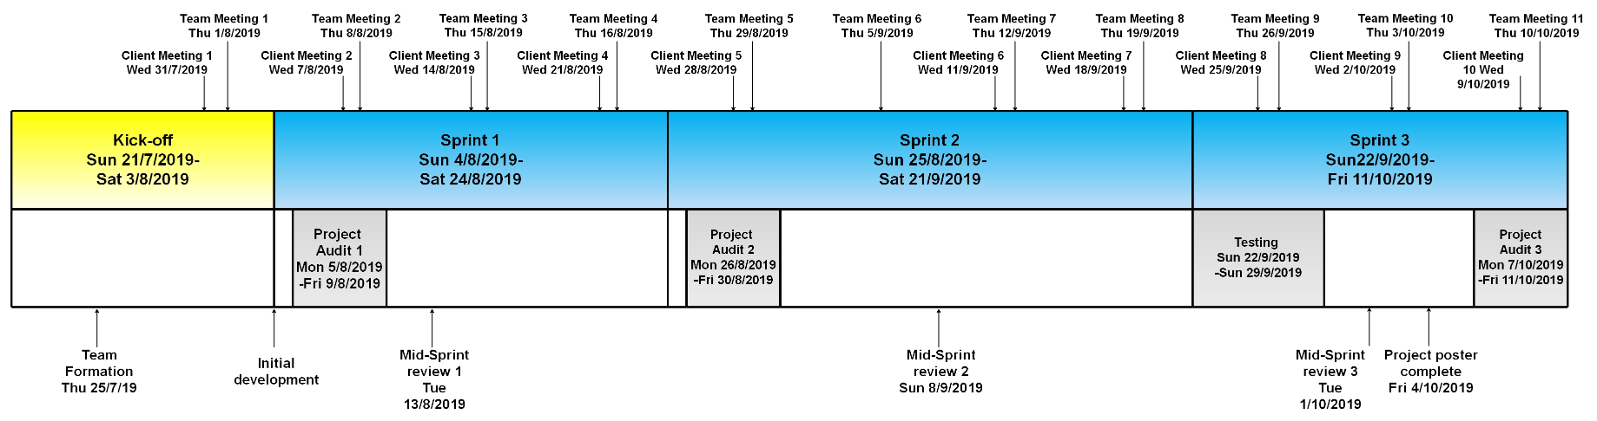
Project Schedule Kick-Off: Weeks 1 - 2. Sprint 1: Weeks 3 - 5. Sprint 2: Weeks 6 - 7. Sprint 3: Weeks 8 - 10.
Intelligent Course Scheduler
Kick-Off: Weeks 1 - 2. Team member recruitment, onboarding, project definition and setup.
Sprint 1: Weeks 3 - 5. Project Audit 1, read and update feature for graphical user interface.
Sprint 2: Weeks 6 - 7. Project Audit 2, create and delete feature for graphical user interface, access control.
Sprint 3: Weeks 8 - 10. Project Audit 3, copy and paste feature, project poster.

Slide 7
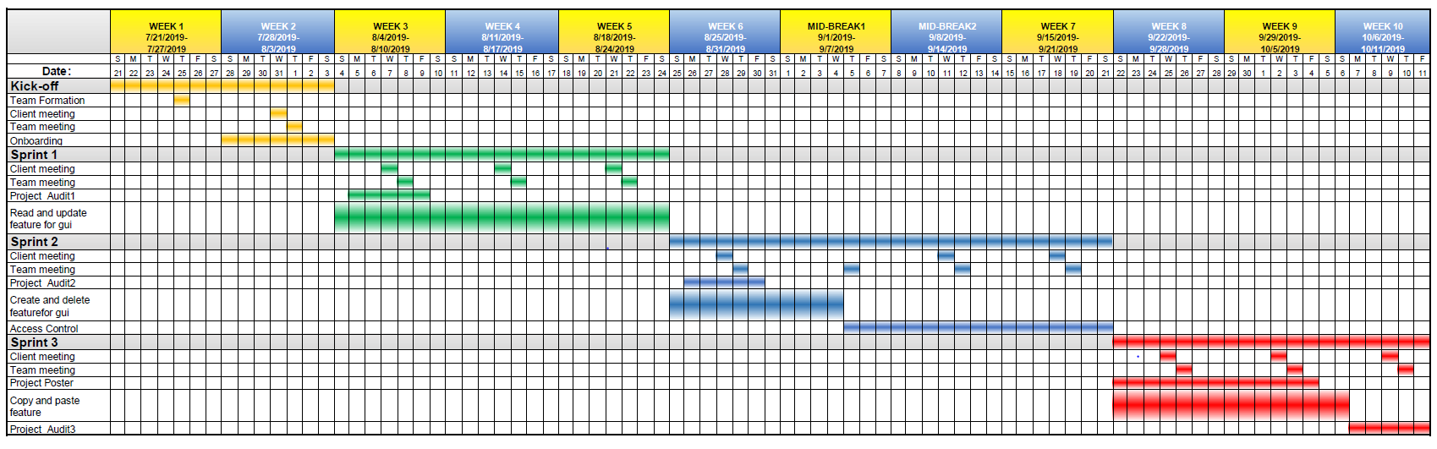
Intelligent Course Scheduler
Project Gantt

Slide 8
Client's Vision
Intelligent Course Scheduler
Improving the recommendation algorithms
Dynamically auto-generated degree plans for students
More useful information about courses (like reviews)

Slide 9
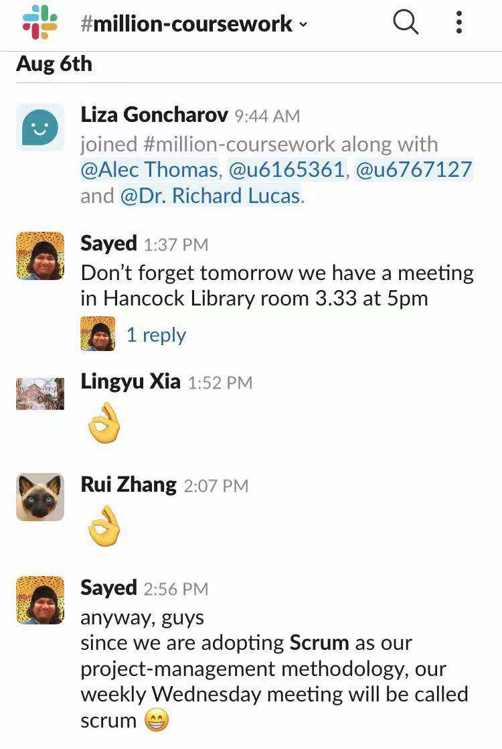

Team communication
Intelligent Course Scheduler
https://millioncourse.slack.com

Slide 10
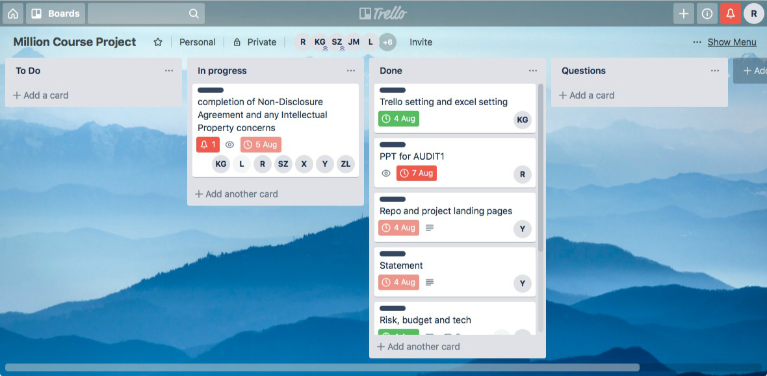
Task management Trello board "Million Course Project"
Intelligent Course Scheduler
https://trello.com/b/NZ6f3hWP/million-course-project

Slide 11
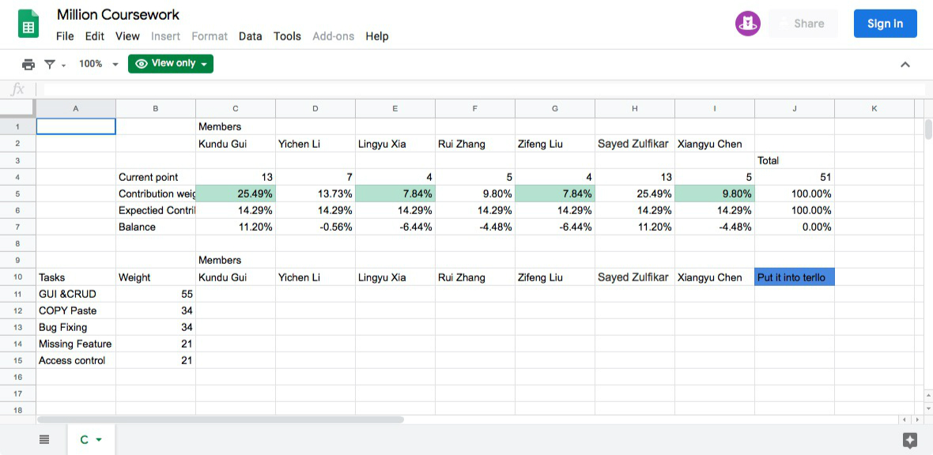
Contribution management Google excel
Intelligent Course Scheduler
https://docs.google.com/spreadsheets/d/1VDyPTPGakaePHO59xfDXeRE0bjdDeTqzyIgMXlnG3V4/edit?usp=sharing

Slide 12
Project Impact
Intelligent Course Scheduler
Students will be able to experience a better user interface which will make their course selection clear and efficient. The access control function allows Anu staff update the course information as soon as possible which will bring more convenience to students.
For some specific majors, some bugs occur when students select course and this website can not be used normally on the mobile services. After fixing these bugs, it could bring a better experience for university students.
We believe that this project will encourage students to explore more about courses and enable students to consider a greater number of options when enrolling. As a result, the proposed project would enhance student experience and university life.

Slide 13

Technical and Other Constraints
Intelligent Course Scheduler
Database Update
Safety
Access Control

Slide 14
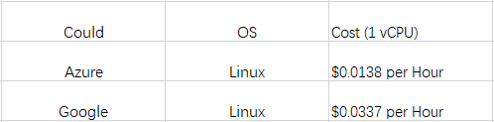
Resources, Risks and potential Costs
Intelligent Course Scheduler
Firstly, there are always some uncontrollable factors in our work.
Secondly, we should guarantee the highest quality of our product in the shortest time. Some mistakes would reduce quality.
Thirdly, relationship between teammates is also a kind of risks.
Budget for the Could Server:

Slide 15
NDA and Ip Concerns
Intelligent Course Scheduler
There will be no non-disclosure agreement required.
Any materials, tools, methods/techniques and software provided by Clients advised and agreed to be Clients’ Copyright, will remain the intellectual property of Clients. New codes developed by project members will be owned by project team.

Slide 16
THANK YOU
Intelligent Course Scheduler
References
Galitz, W. O., & Safari Books Online. (2007). The essential guide to user interface design: An introduction to GUI design principles and techniques (3rd ed.). Indianapolis, IN: Wiley Pub.
Project Repository-github repo-"million-coursework”
https://github.com/million-coursework

